Slide 1
PASTE THE STREAM GENERATION MODULE IN FOLLWING PATH OF YOUR SYSTEM:
C:\Users\dtdb7\AppData\Roaming\QGIS\QGIS3\profiles\default\processing\models

Slide 2
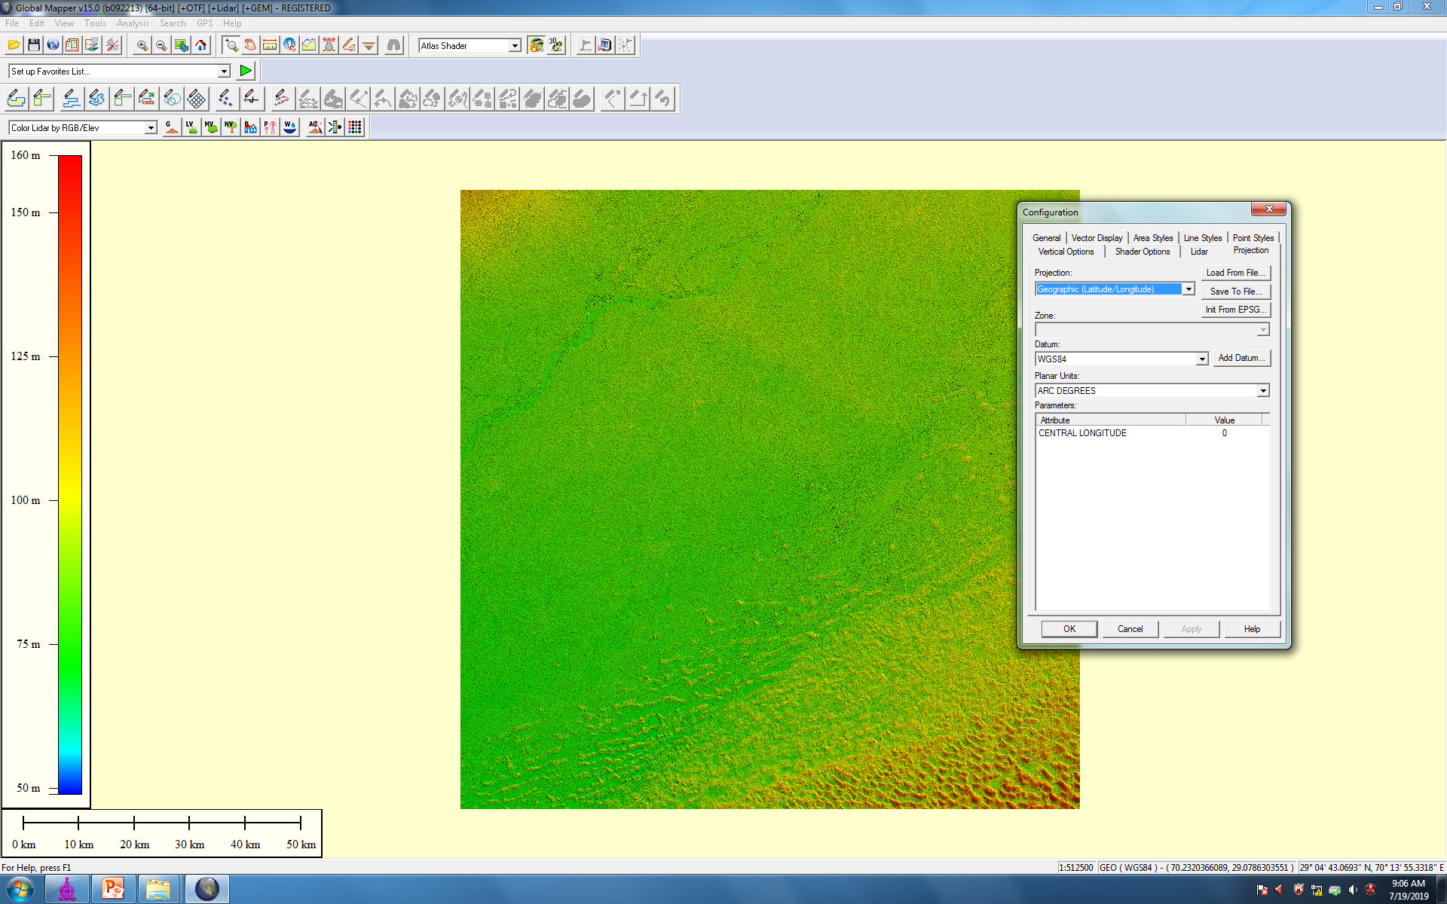
OPEN THE DEM FILE(.BIL FORMAT) IN GLOBAL MAPPER AND CHANGE THE PROJECTION AS UTM AND EXPORT REQD AREA IN .TIFF FORMAT

Slide 3
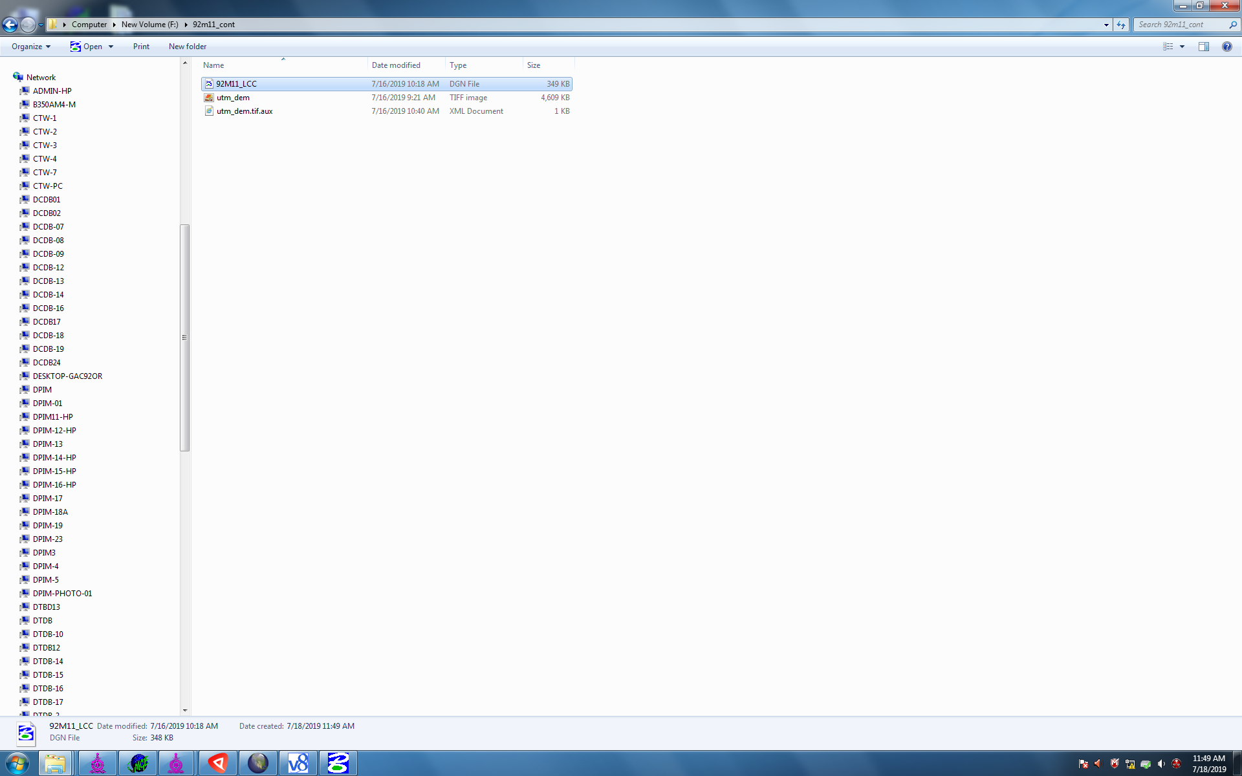
TAKE THE UTM DEM AND LCC SEED .DGN FILE IN YOUR FOULDER

Slide 4
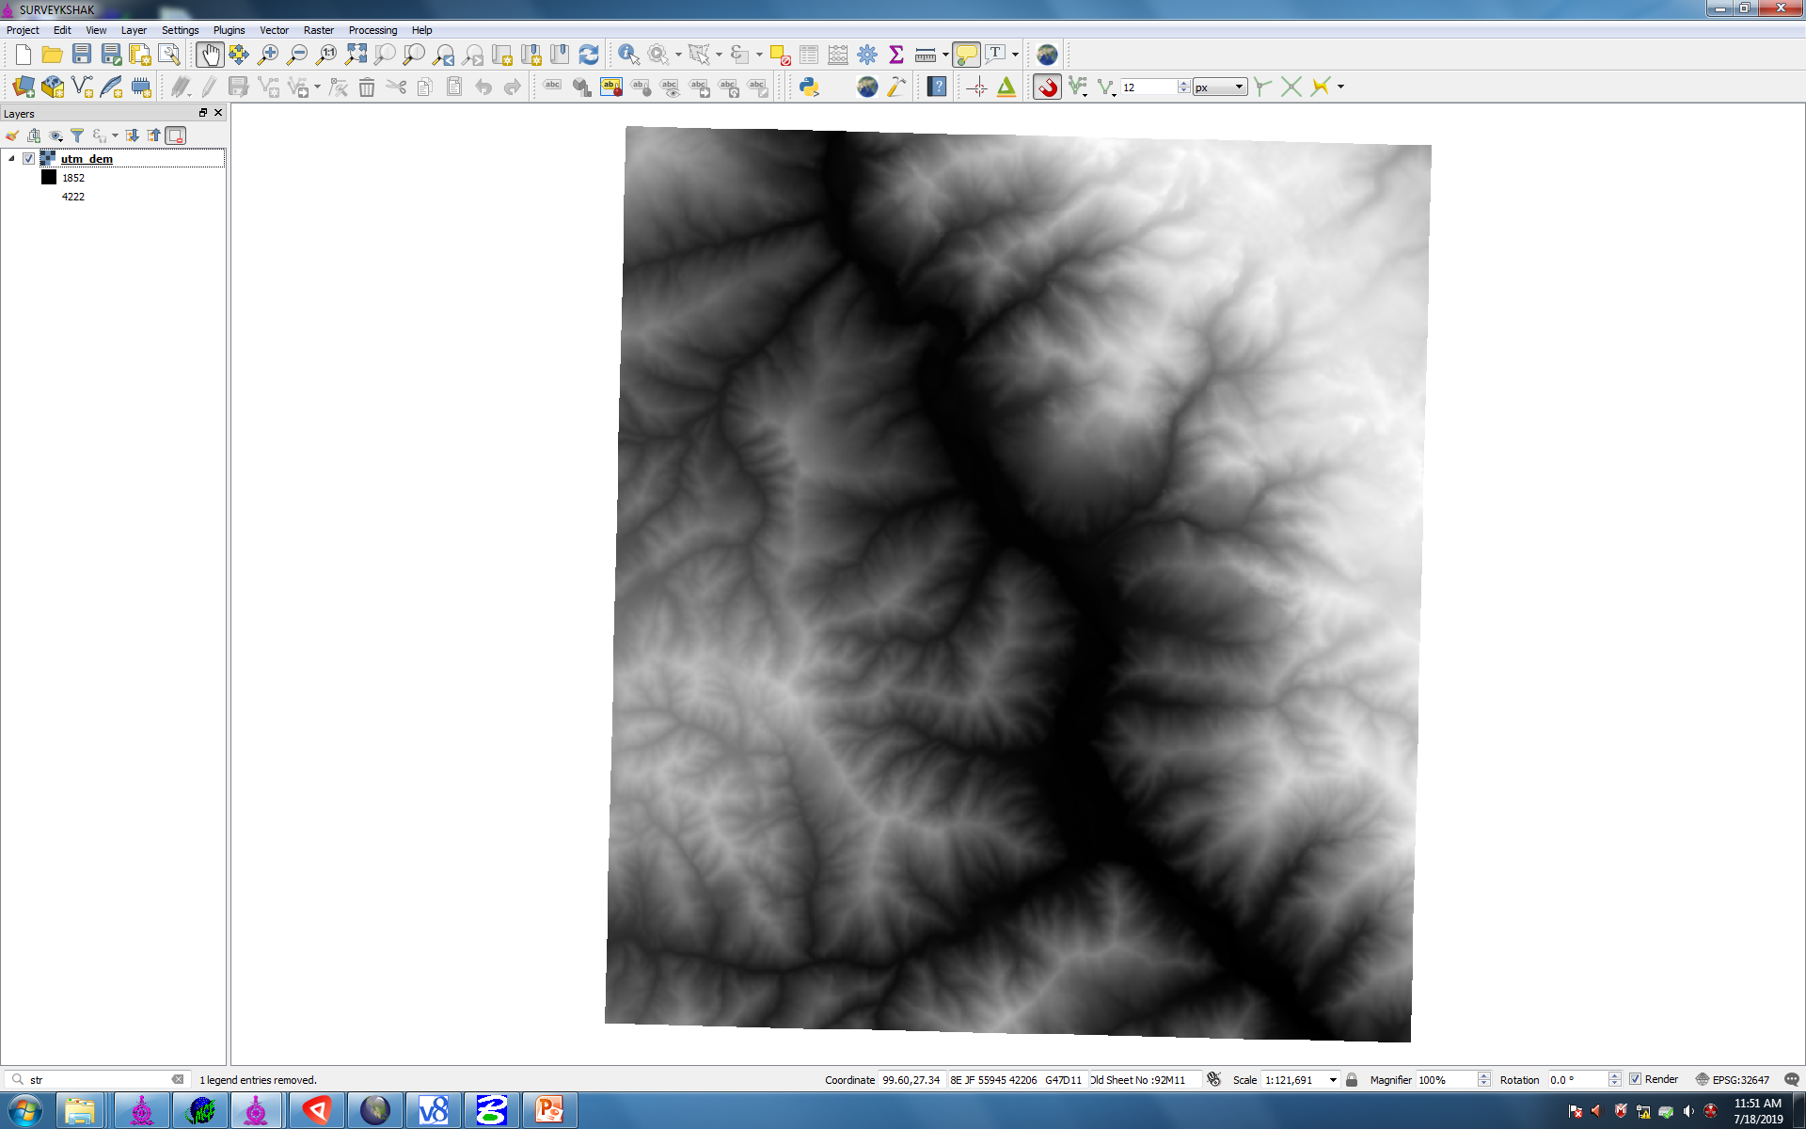
OPEN THE UTM DEM IN SURVEYKSHAK
TYPE STR IN PROCESSING MENU

Slide 5
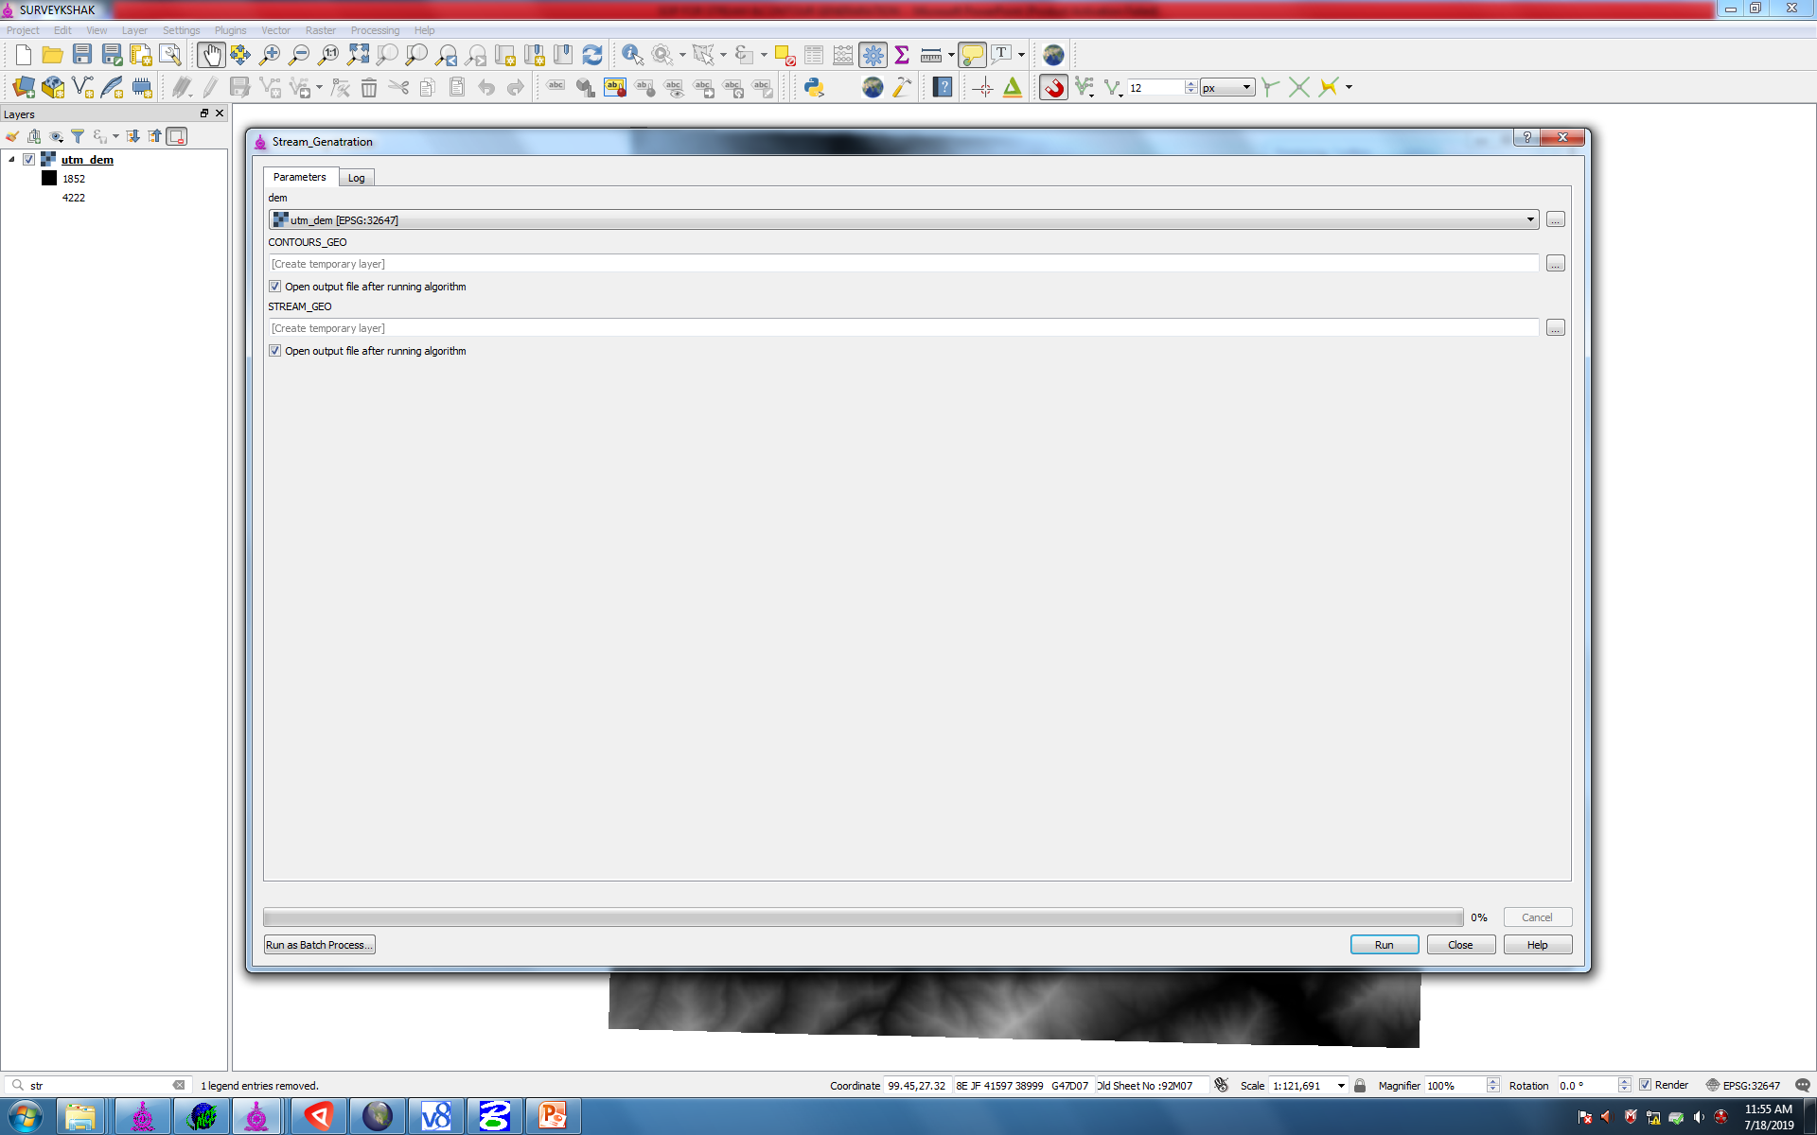
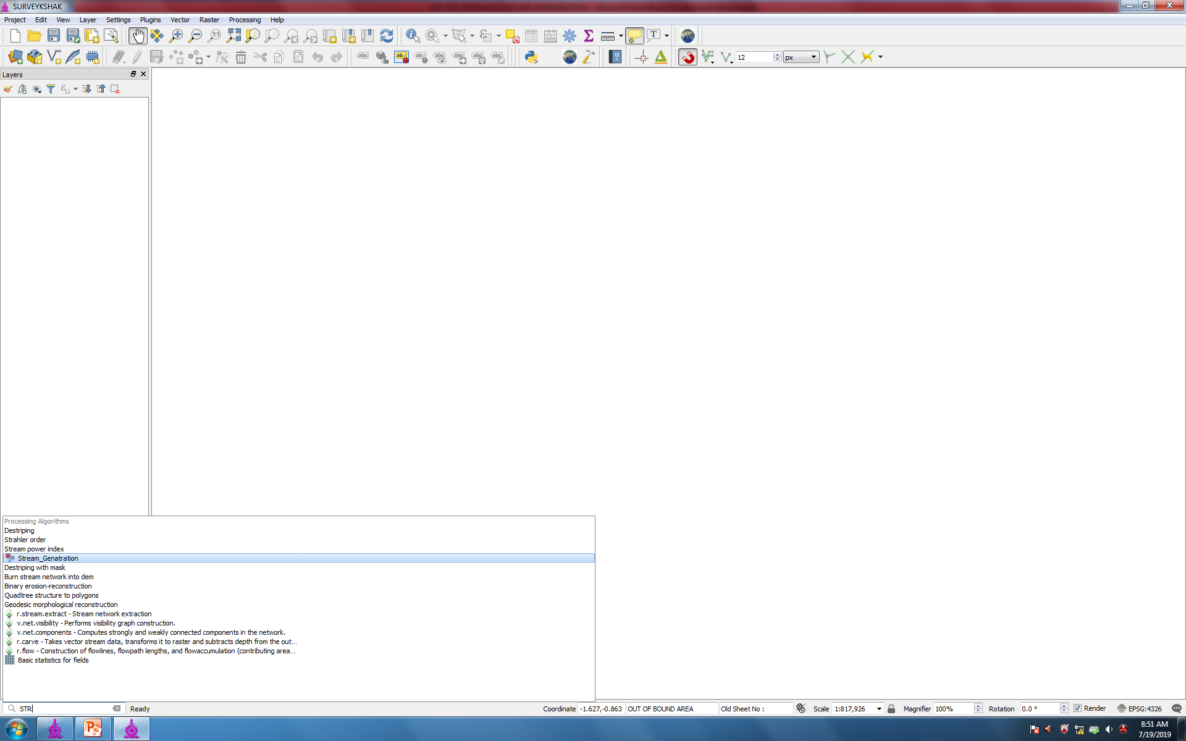
OPEN THE STREAM GENERATION MODULE

Slide 6
SELECT THE UTM DEM & RUN

Slide 7
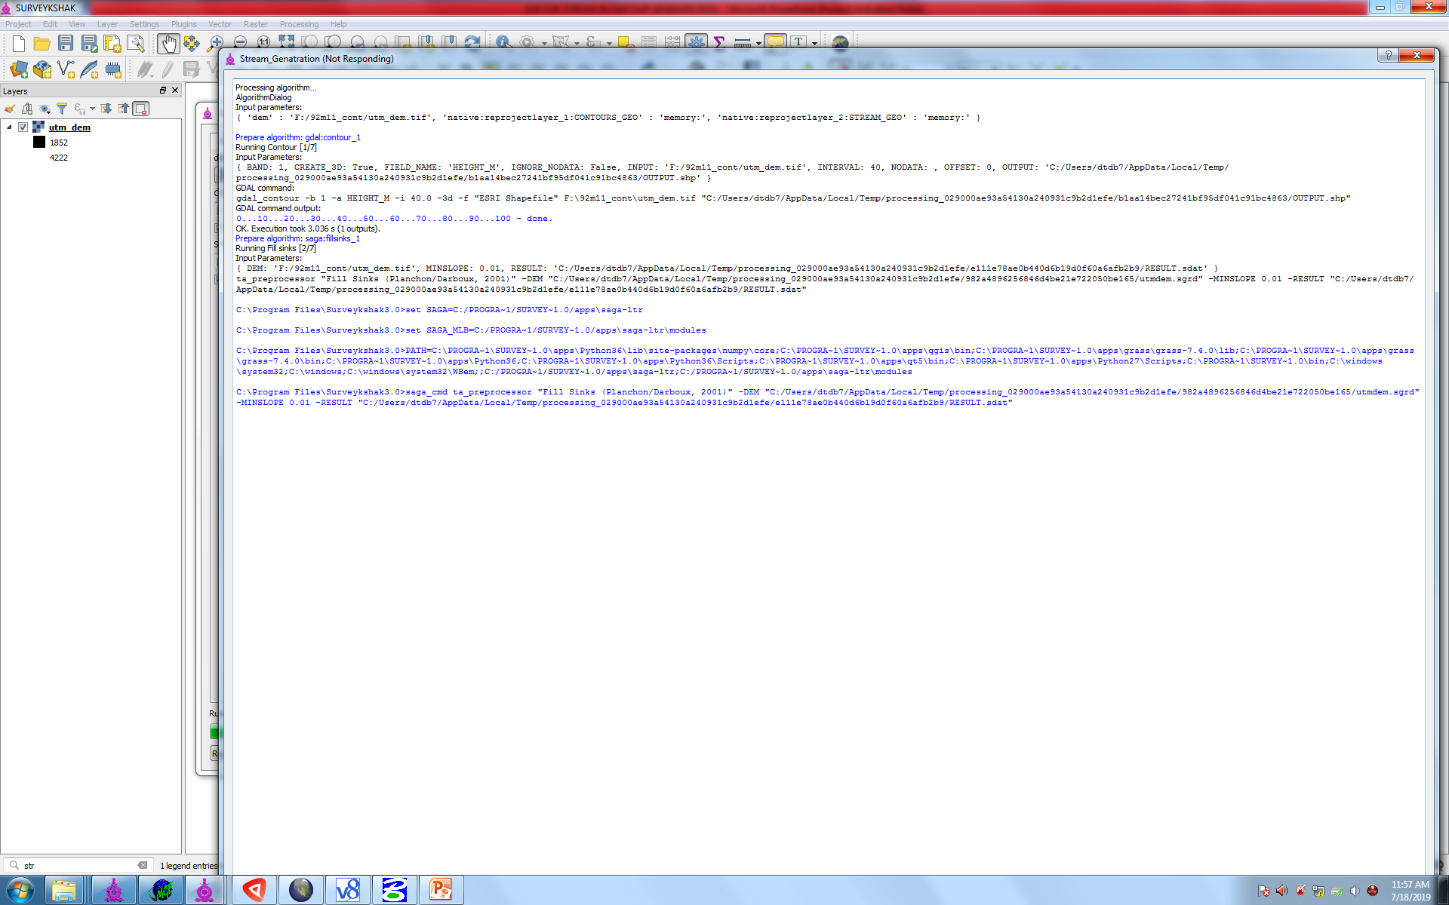
AUTO PROCESS WILL START AND WILL BE COMPLETED IN 5 TO 10 MIN

Slide 8
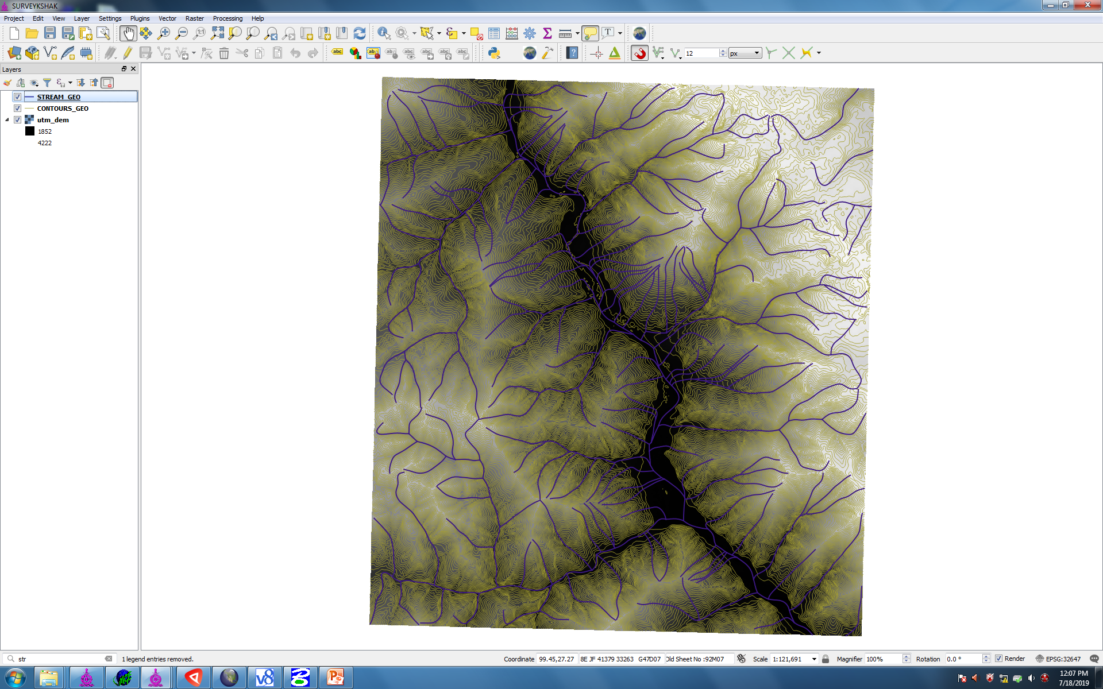
STREAM AND CONTOUR WILL BE GENERATED

Slide 9
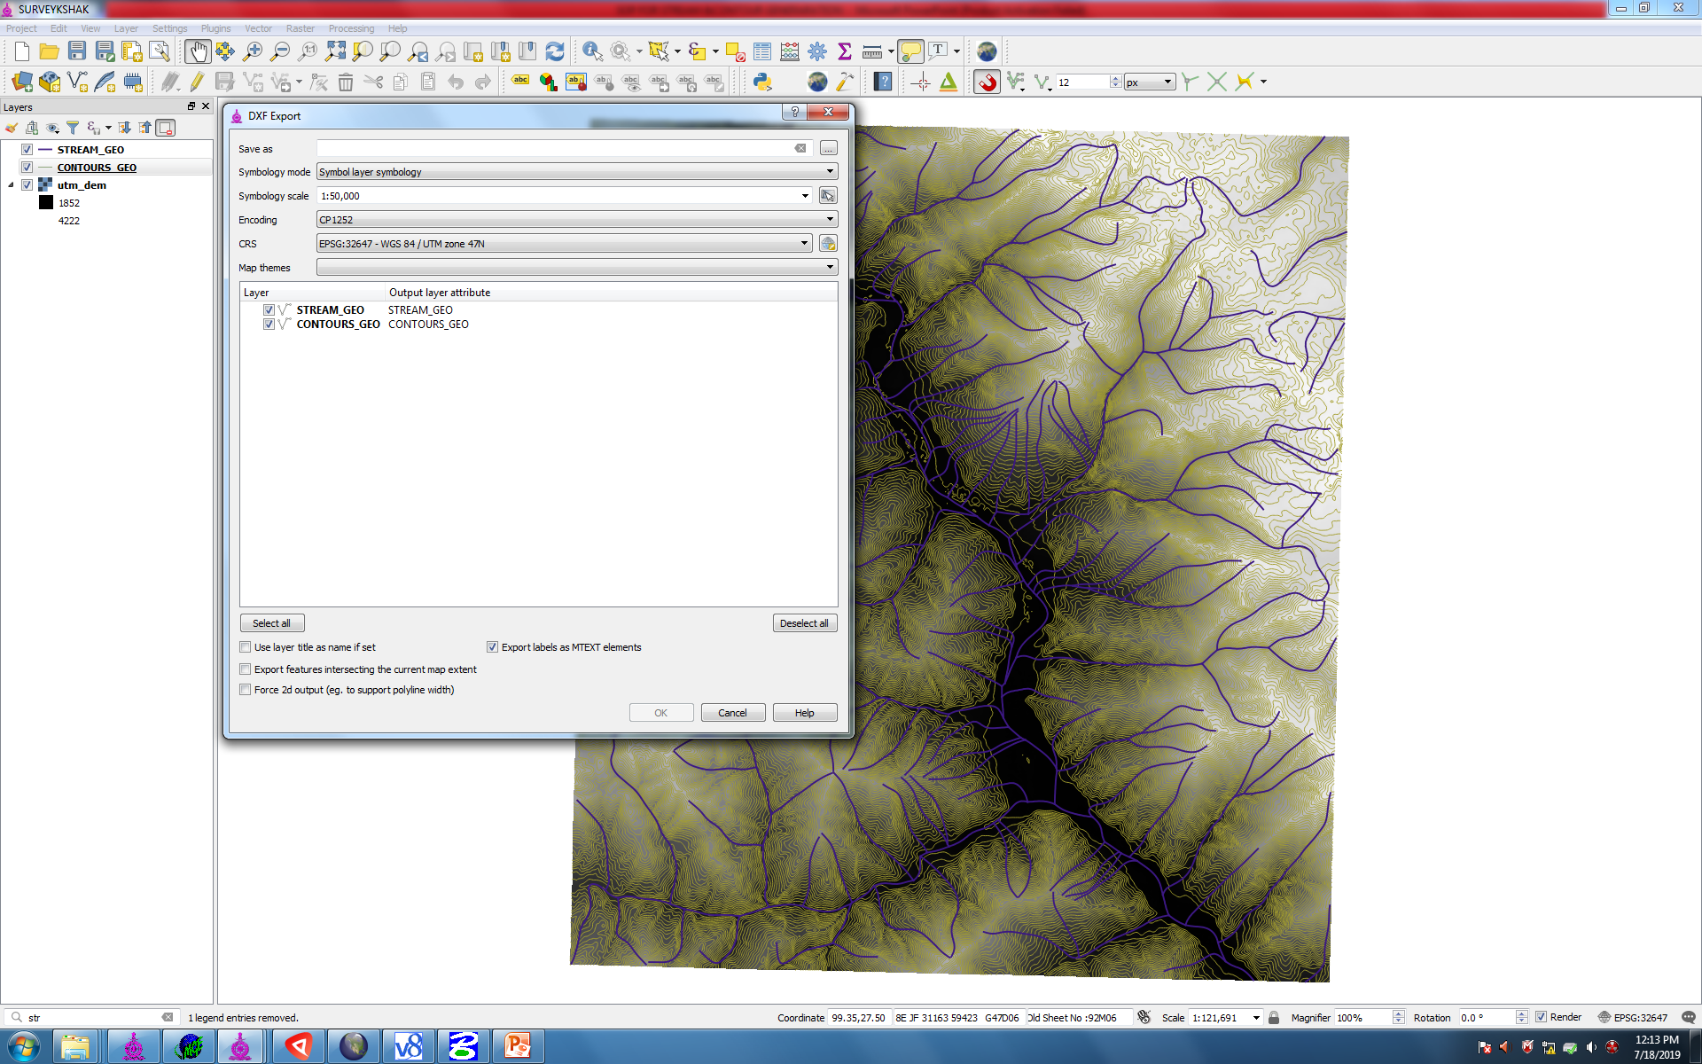
CONTOUR AND STREAM WILL BE GENERATED. GO TO PROJECT AND EXPORT TO .DXF FORMAT

Slide 10
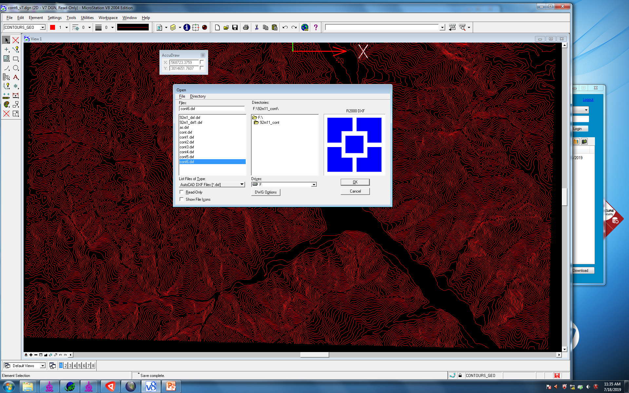
OPEN THE .DXF CONTOUR FILE IN MICROSTATION V8 AND EXPORT IT TO 2D .DGN FILE

Slide 11
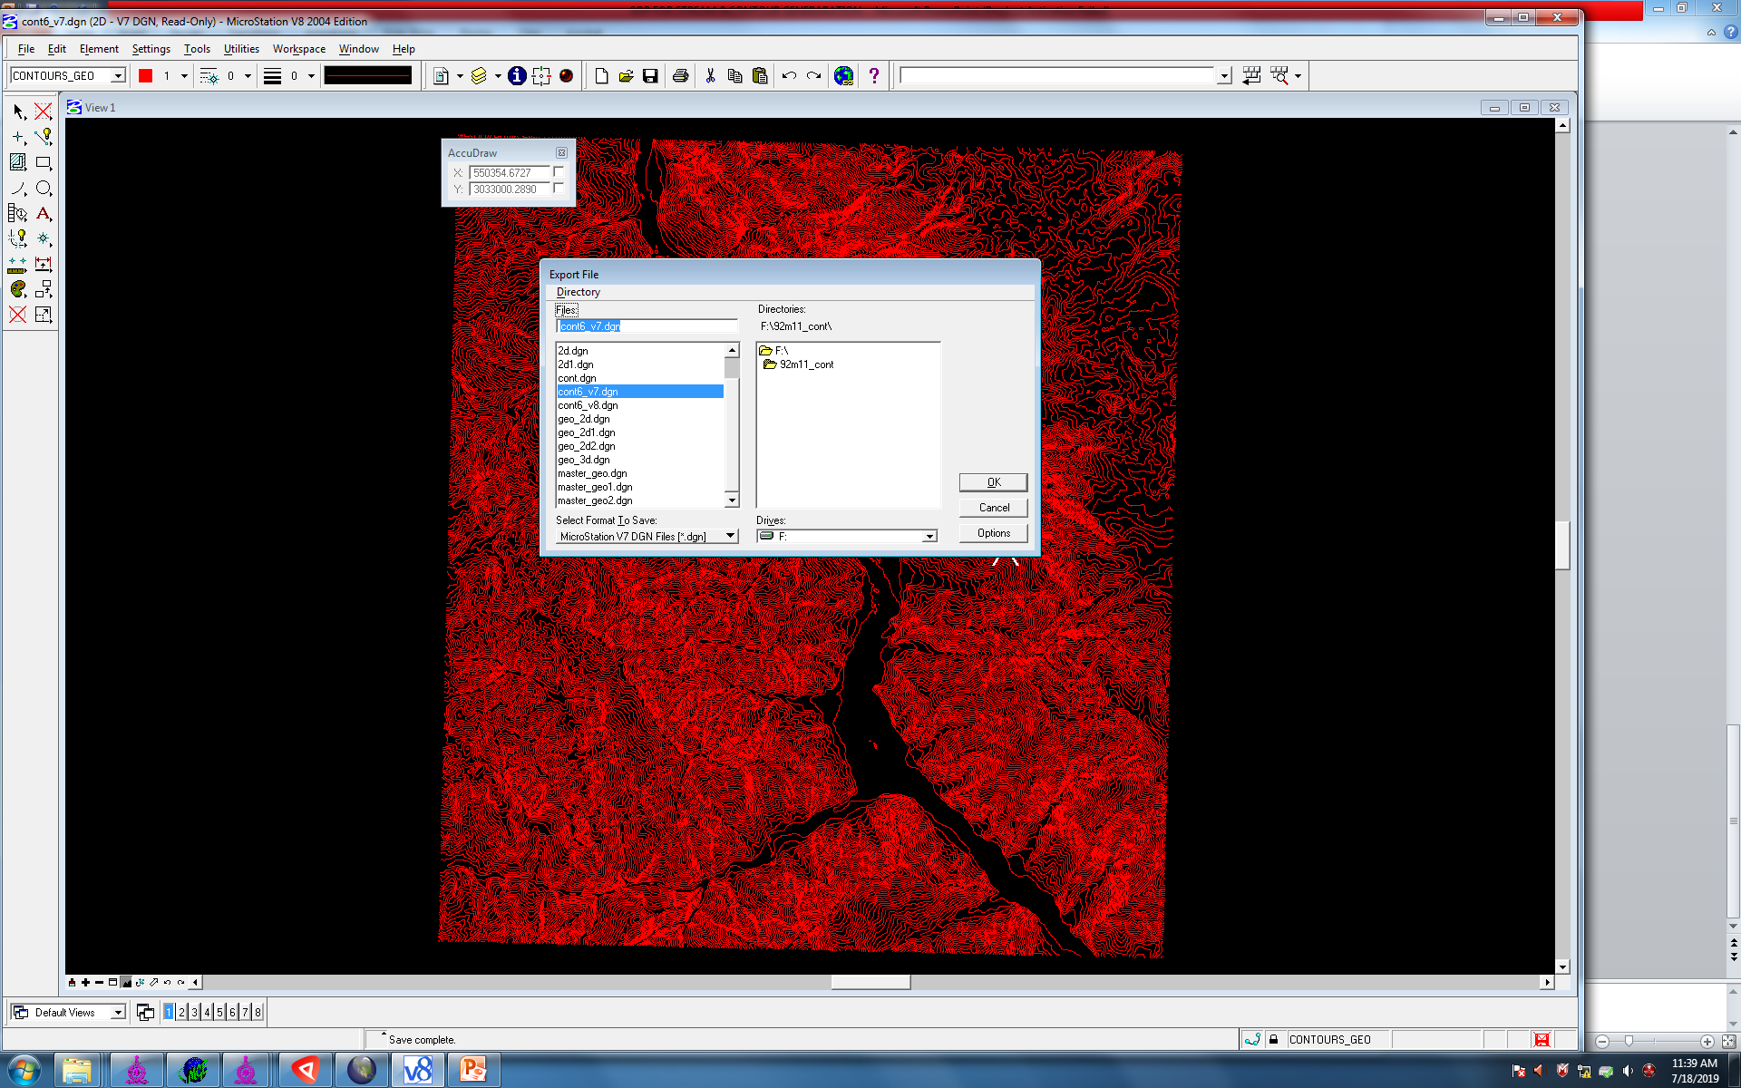
OPEN THE 2D FILE IN V8 AND EXPORT TO V7

Slide 12
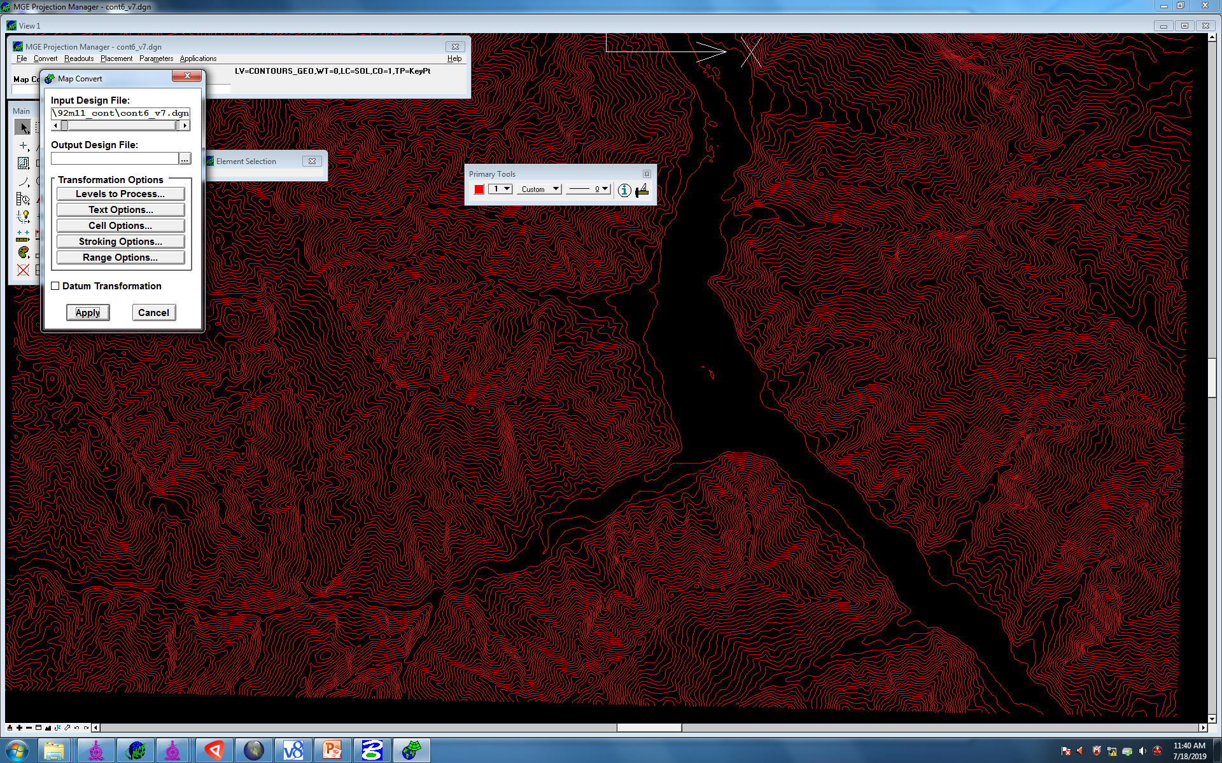
OPEN THE V7 FILE IN MGE CHECK THE HEIGHT VALUES AND CONVERT IT TO LCC/WGS 84

